Slide 1
YouTube Trending Videos
Jialun Lyu, Lin-Ying Cheng, Weihua Huang, Yiwei Zhang
Group 13 ECE 143 Fall 2018

Slide 2
Overview
YouTube is the most popular video streaming platform in the world
Total Number of Monthly Active YouTube Users: 1.9 billion
Number of Videos Watched Per Day: 5 billion
Reference: https://www.omnicoreagency.com/youtube-statistics/

Slide 3
Motivation
It is interesting to know whether a video is popular is dependent on its category and the cultural background of viewers.
Also, we want to show how the cultural divergence affects people’s attitude toward different types of videos
Shed light on how YouTubers are supposed to refine their videos to get more subscribers, and recommend popular channels of particular video genres.

Slide 4
Datasets
Trending YouTube Video Statistics:
Contains about 200k trending videos’ information from 5 different countries in csv files
Contains 32 types information of videos in json files

Slide 5
Methodology
Sum up all views of all videos and sort in descending order to know what category of videos is popular
Analyze the published time of all videos and sort in 24 hours to understand when is popular hour to publish videos
Utilize number of comments and views to calculate how people interact with the youtuber

Slide 6
Time

Slide 7
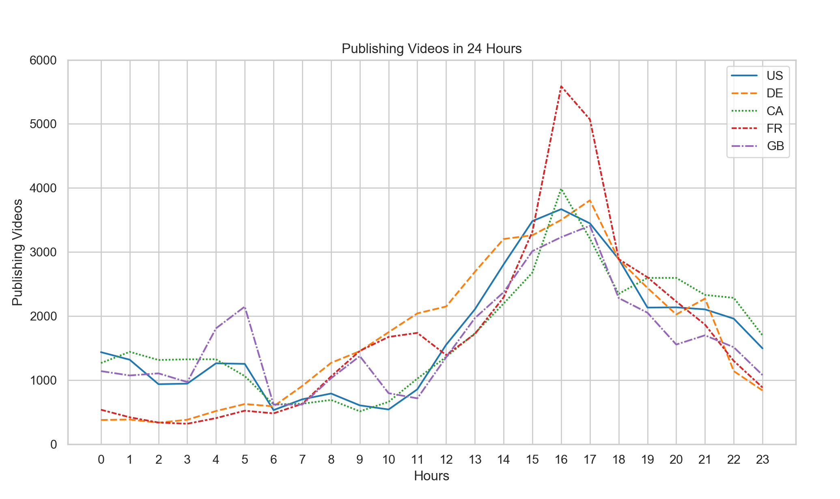
The publishing time of trending videos distribution concentrate at 4pm - 5pm
In France, the publishing time distribution are much more concentrated than other counties

Slide 8
Views

Slide 9
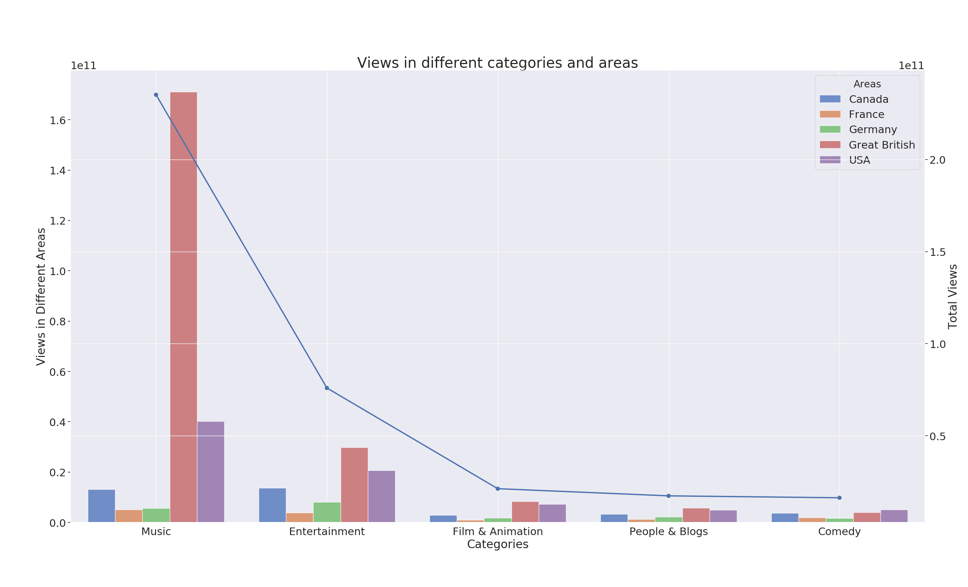
These are the top 5 categories with the most number of views.
We can infer that people prefer watching videos to relax.
As we can see, category, Music, has the most views.
Especially because Ed Sheeran - Perfect in Great British has the most views

Slide 10
Comment ratio

Slide 11
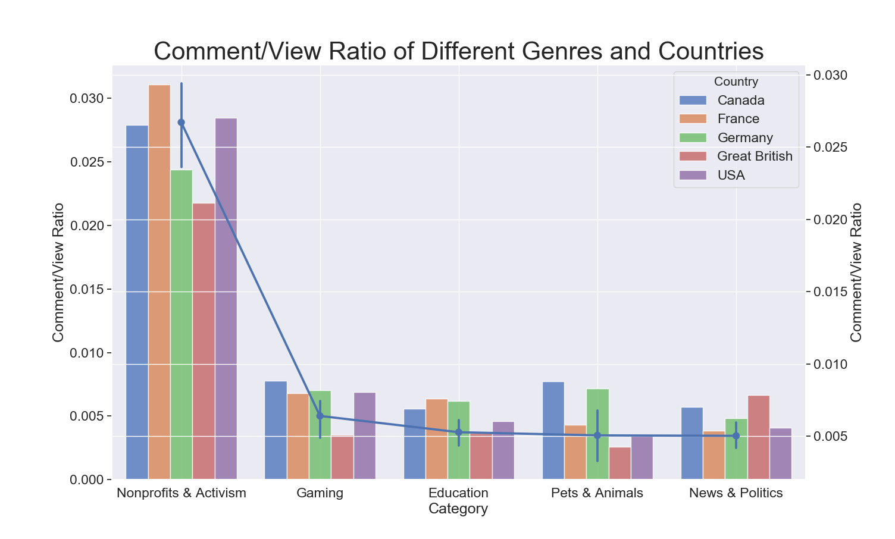
On average, Every 1 in 200 viewers would write down something under the video unless the video is related to Nonprofits & Activism, the Comment/View Ratio of which is 2.5%.
Notes:
People are more inclined to express their opinions after watching videos regarding Nonprofits&Activism, as we are concerned about something related to society improvement.
Generally, British are less willing to post their comments except that News&Politics can usually grab their concerns.
Canadians are talk-active when they watch relaxing videos, such as Gaming, Pets&Animals, Comedy and People&Blogs.
Most of the viewers on YouTube are young, and thus making the Comment/View ratio of Gaming relatively high.

Slide 12
Attitude

Slide 13
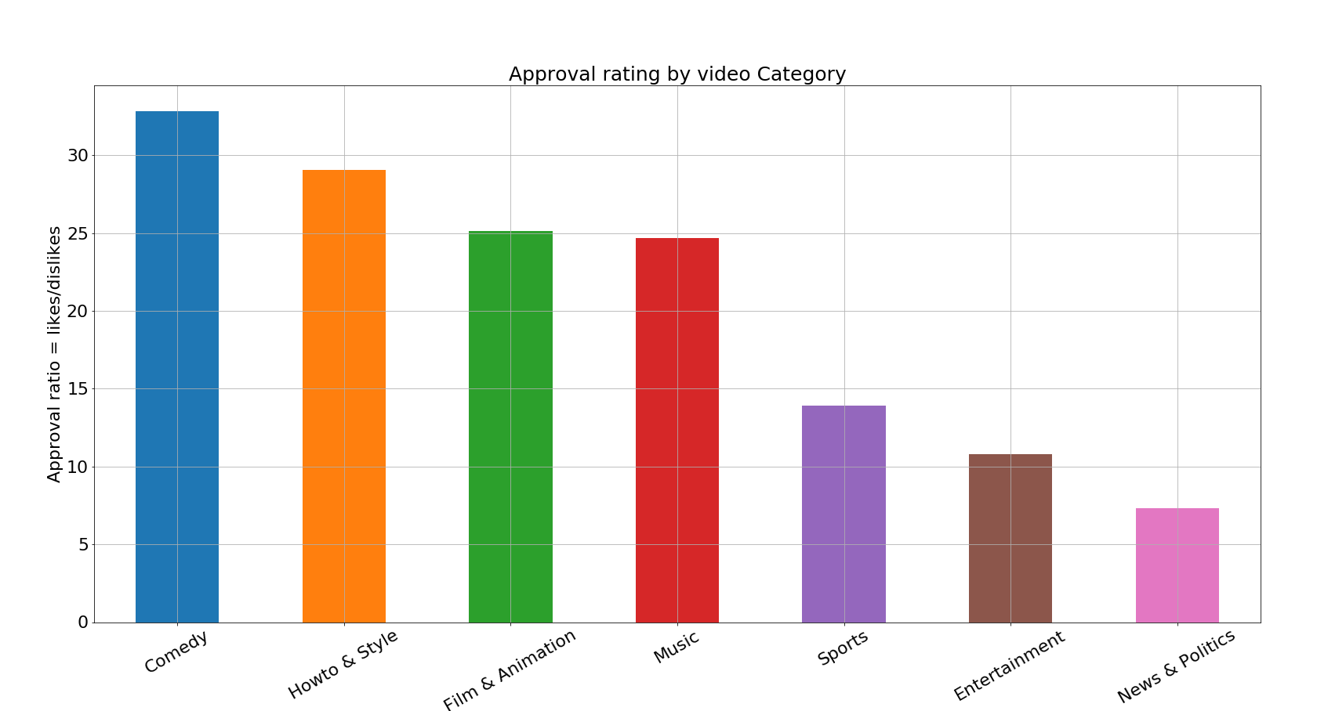
Ratio of likes and dislikes as an indicator of audience approval rating for the video content
The approval rate vary among different genres for popular videos.
Animal,Comedy and Education have highest approval rate. Audience generally respond positively to these types of videos
People tend to have divided opinions when viewing video of type News & Politics and Nonprofits & Activism

Slide 14
One more thing …

Slide 15
Controversial

Slide 16
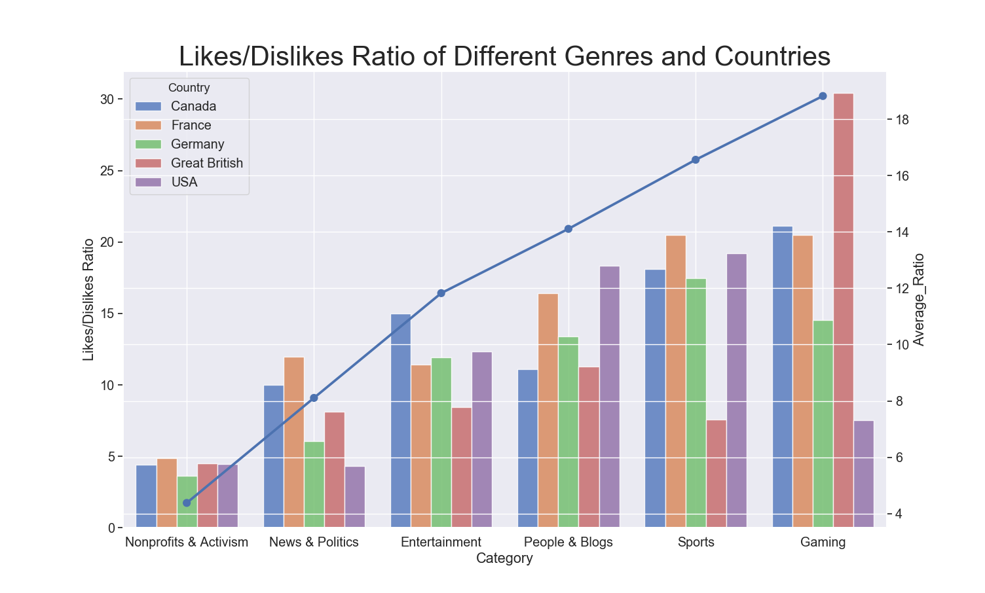
Nonprofits & Activism, News & Politics and Entertainment are the 3 most controversial topics.
All categories listed somewhat reflect what famous celebrities do, which can easily cause debates.

Slide 17
Conclusion

Slide 18
People prefer watching videos to relax and Music has the most views.
People are more inclined to express their opinions after watching videos regarding Nonprofits & Activism, as we are concerned about something related to society improvement.
Audience generally respond positively to Animal, Comedy and Education
Nonprofits & Activism, News & Politics and Entertainment are the 3 most controversial topics, which can easily cause debates.

Slide 19
Thank You

